Slide 1
Innovation:
New Assumptions
Safety net
Families are capable
Families exercise control and choice, utilizing their strengths to act
Families are needy
Families viewed as in crisis and in need of outside help to make progress
Invest in initiative
Positive actions keep, or even increase, eligibility for resources (strength-based)
Penalize progress
Access to benefits are reduced if the family makes progress (needs-based)
Self-determined path
Family acts on their own goals and determines steps for self advancement
Prescribed path
Family directed by case managers or follows a process determined by a program
Mutuality
Family is expected and encouraged to share resources/expertise and assist others in community
Dependency
Program is positioned as primary support of family inadvertently reducing the importance of peers and community

Slide 2
Current System
FII’s Model
Consumer Driven Demand
More Families
Funders & Policymakers
The “Peoples Yelp”
Name of Service Organization
Feedback
Service Organizations
Based on 100 reviews
Comments:
- ‘Good agency but poor staff …..’
‘Don’t go there, go to ____’
- ‘Email me and I can help you….’
FII
Families

Slide 3


FII, FUNDERS, POLICY & NONPROFITS GET TO SEE WHAT FAMILIES WANT, DO AND HOW THEY RATE SERVICES WE DEVELOP
Families input data, surveys & rate svcs

Slide 4
Opportunity Platform—Access based on initiative
Outcomes
Traditional Lending Circles
Nano-Loans
Personal Donors
Tax Benefits
- Rid of predatory debt
- Fixing credit rating
- Startup capital
- Tax break, jobs created
- Joined Lending circle
Financial Tools
Credit bldg. lending circles
Self organized circles
0% interest
- KivaZip
- FII Direct
Variable Interest
- Prosper.com
- Credit Unions
Online Donors
- Kickstarter
- Indiegogo
Self – employment
Tax credit…
Matched Individual Savings
Match Group Funds
- Down Payment for home
- Saving for kids college
- Started scholarship fund
- Created jobs with our new business
Match Resident Savings
Match for home, business, educ.
Children’s IDA
In development
Match lending circle funds
Resident raised scholarships $$
Match local investment
Project Outcome Awards
Recognition Awards
Fellowships & Scholarships
Non-monetary Benefits
- Award for cleanup we did
- Energized by recognition
- Helping one another
- Lower/discounted rates
- Donated dental surgery
Awards
Replace grants
Award after resident accomplishments
To stimulate resident initiative
Resident who step up
Group discounts
Donated services
FII Journaling & UpTogether – Online Social Community
Events/Conferences
- Got business mentor
- Exchanged childcare
- Found new clients at mixer
- heard about free tickets
- I can see my progress!
Social Capital
Business /Other Advice, Mentors
Recommend & rate programs
Exchange services
Organize local mixers
Invites to events/trngs.

Slide 5
FII Approach—Bottom Up, Hands Off
Facilitating Natural Networks
Activities
“Core Catalyst Families”
Families enroll with friends (cohort)
Each family gets computer to report progress
Families must meet monthly with cohort and meet with liaisons for quarterly audit of reported progress
Families are paid for reporting their progress (kids grades go up; credit score improves, get part time job). On average families earn $ 160/month
Fellowships are available for emerging leaders and role models emerge
Additional resources are made available for families who meet requirements and take initiative (matches to savings, loans, scholarships, prizes)
Family
Family
Family
Family
Family
FII
liaison
“Ripple Families”
100s requesting to enroll

Slide 6
FII-Boston’s Growth
2010
1000 households
(2700 adults & children)
35 Core Families
200 households
(800 adult & children)
2015
2012

Slide 7



Family Outcomes—Boston
Family Initiative Core & Ripple Families
73% of children reported grade and school attendance improvement
CHILDREN
75% of children attended 34 different afterschool programs
60% of households led a community activity (e.g. youth workshops, women’s support groups, housing planning)
MUTUALITY
80% of households helped someone in the community (e.g. help get a job, offer a loan, provide childcare)
Financial Outcomes Core & Ripple Families
27% rise in Core family avg. income after two years and, 15% avg. rise for Ripple families after one year
53 businesses operated by FII families, with an estimated 80 jobs (FTE’s) created by businesses
4 new homeowners – 2 from Core families and 2 from Ripple.
187% avg. rise in Core savings for avg. balance of $1,715 and Ripple rose 167% for $1,211 avg. balance

Slide 8
Key Findings from Independent Evaluation
Half of the families living below poverty when they joined FII moved out of poverty within two years.
Families report that FII provides them with structure that allows them to set and attain realistic goals.
Core and Ripple families credit their experience in FII for their expanded social networks and for teaching them how to seek out the resources they need.
All but one Ripple cohort experienced an increase in savings, with 11 of the 17 cohorts experiencing an average savings growth of more than 200%.
Five of the original six Core groups continue to meet after completing their two–year commitment to FII.
Overall, Core families markedly increased their sense of options, and moderately increased their sense of control and perception of social connectedness.
Core families describe their FII cohort as “family,” bonding together in shared causes, impacting their communities and improving their well-being. Ripple cohort members are bonding together to make positive changes in their communities.

Slide 9
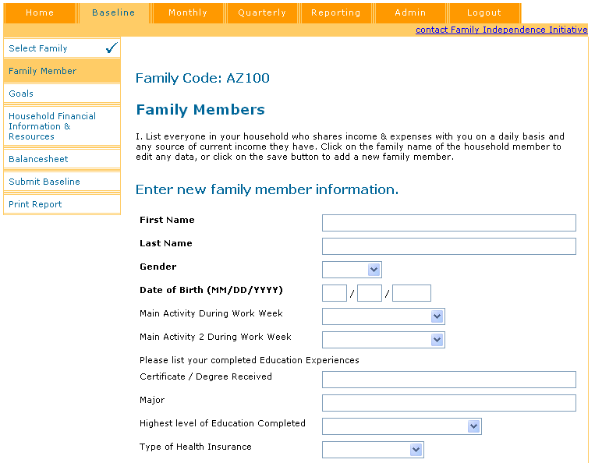
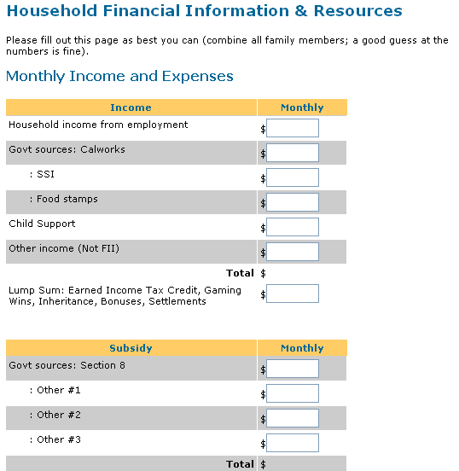
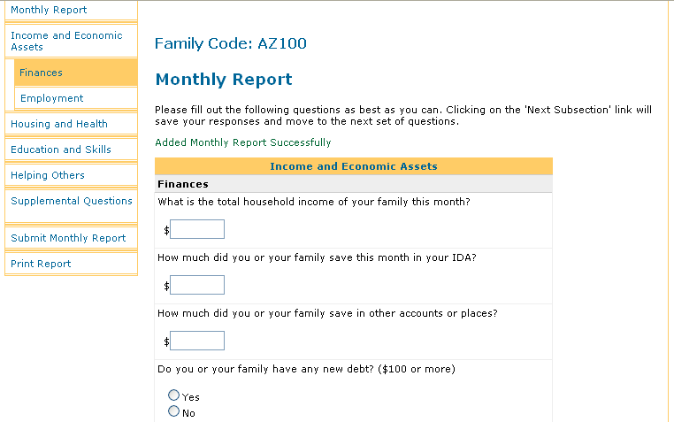
Data Collection and Consumer Feedback
Set a baseline, track monthly, quarterly, and yearly
Track
Income
Asset Growth
Awards
Participation
Ripple/Network
Community
Interaction

Slide 10
Sample of Data Collected Monthly
HOUSEHOLD INCOME
HOUSEHOLD
BALANCE SHEET
HOUSEHOLD ACTIVITIES
Income from Employment
  Formal (W-2, 1099-INT)
  Informal (Under the table)
Own Business
  Formal
  Informal
  Type of business
Child Support
Other Income (Not FII)
Supplemental Security Income
Unemployment Income
Lump Sums
Food Stamps
Calworks/ DTA
WIC
Subsidized Portion of Housing
Other
Savings Account
Checking Account
Cash On Hand
Personal Loans Others Owe You
Credit Card Debt
Auto Loans
Education Loans
Personal Loans Owed
Real Estate Loan
Alimony
Child Support
Other Debt/Obligations
Credit Score
Education & Skills
Improved Grades
Improved Attendance
After School Programs
Graduation
Scholarships
Adult Classes
Workshops
Continuing Education
Health & Housing
Insurance Coverage
Preventative Care
  Checkups
  Routine Test
  Immunizations
  Therapy
  Mental Health
Health Improvement
  Weight Loss
  Join Gym
  Blood Pressure
  Cholesterol
Bought a Home
Moved (Reasons)
Improved Housing
Networking & Helping
Refers Friend to a Job
Helps Other Start Business
Refers Other to Resource
Helps Others in Crisis
Expands Job Networks
Recruits & Orients New FII Families
Resourceful & Leading
Attend Trainings
Shares Training
Involved/Lead Civic Activities
Attends Leadership Workshops
Leads FII Activities

Slide 11
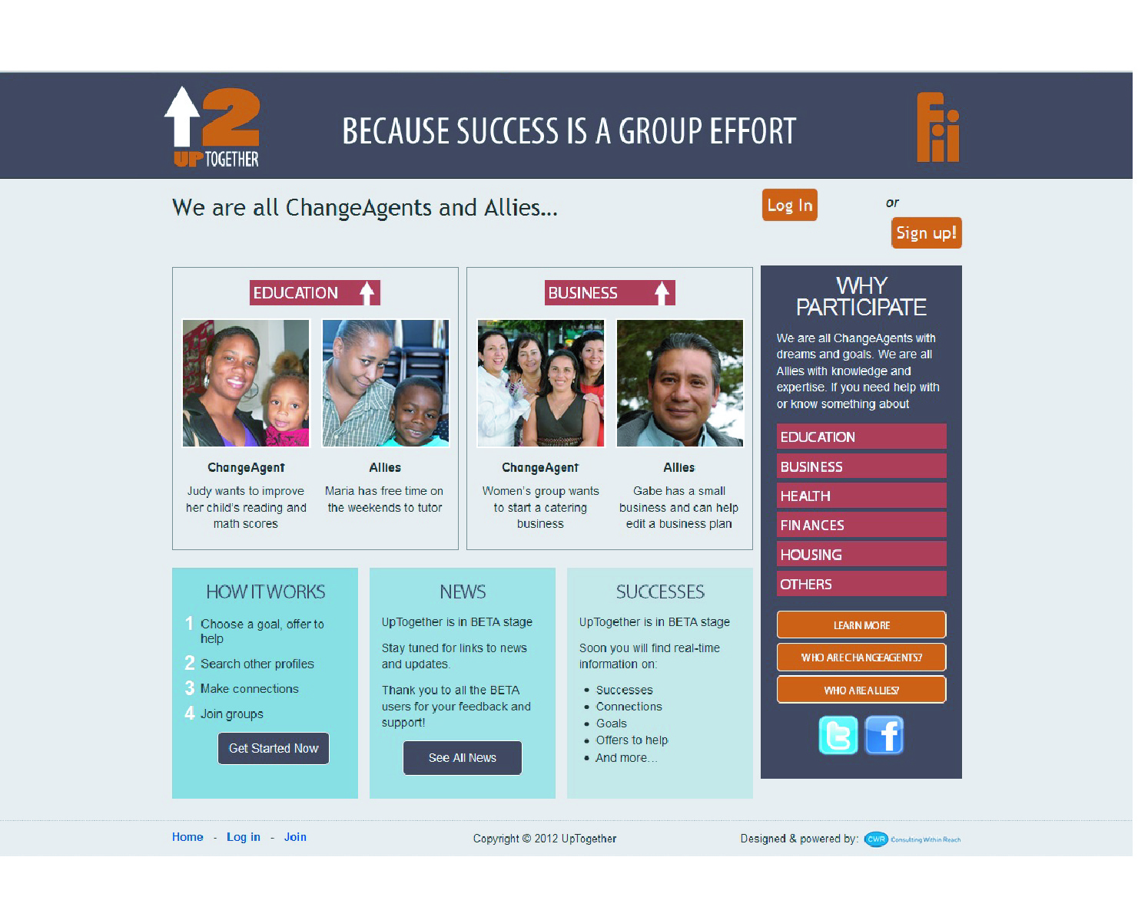
Innovation: Social Networking/Assistance Online

